Slide 1
Blood Bucket
Blood Donation Management System

Slide 2
Supervised by DR. PROF. SADIQ ALI KHAN Developed by Aiman Mohsin (EP1650006) Hareem Zubair (EP1650020) Khadija Yousuf (EP1650027)
DEPARTMENT OF COMPUTER SCIENCE
UNIVERSITY OF KARACHI
2019

Slide 3
ABSTRACT
The objective of this application is to developing an online Blood Donation Information.
The Blood Donation Agent is to create an information about the donor and organization that are related to donating the blood.
This System is used for maintain whole information about donors, receivers.

Slide 4
EXISTING SYSTEM
No Global Information System, every organization have there own.
Retrieval of data takes lot of time
Mostly Systems are not user friendly

Slide 5
PROPOSED SYSTEM
System makes the overall project management much easier and flexible.
Upload the latest updates, allows user to see the alerts by clicking the URL.
User friendliness I provided in the application with various controls.
We provide Android Application.
Also provide SMS Service.

Slide 6
TECHNOLOGIES USED
Operating System : Windows
Web Technologies : Asp.net Core
. Net Framework 4.6.1
Android Technologies : Android 8.0 (Oreo)
Database : SQL–Server - 2014

Slide 7
MODULES
Login Module
Main page Module

Slide 8
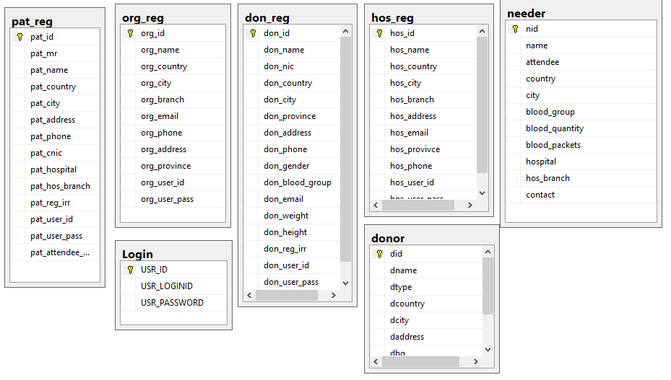
ERD - Diagram

Slide 9
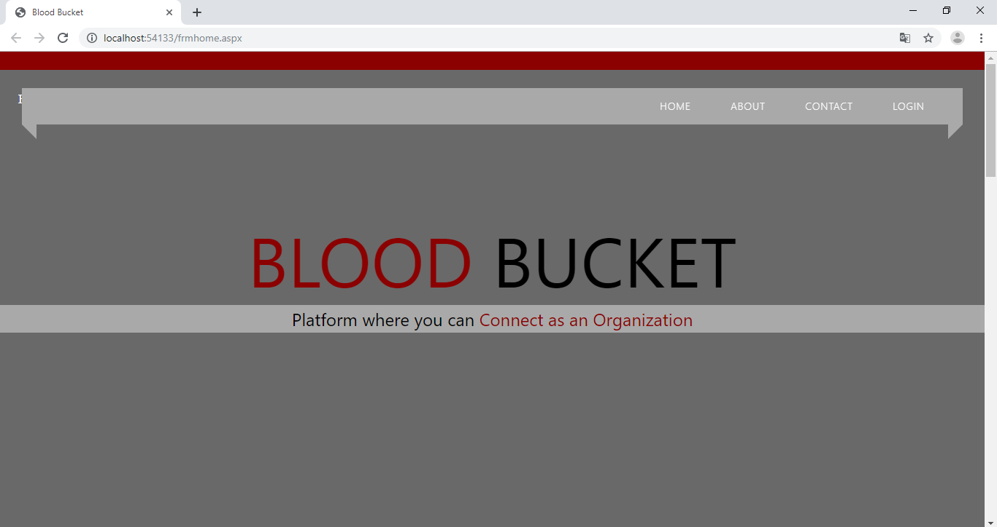
Web Application

Slide 10
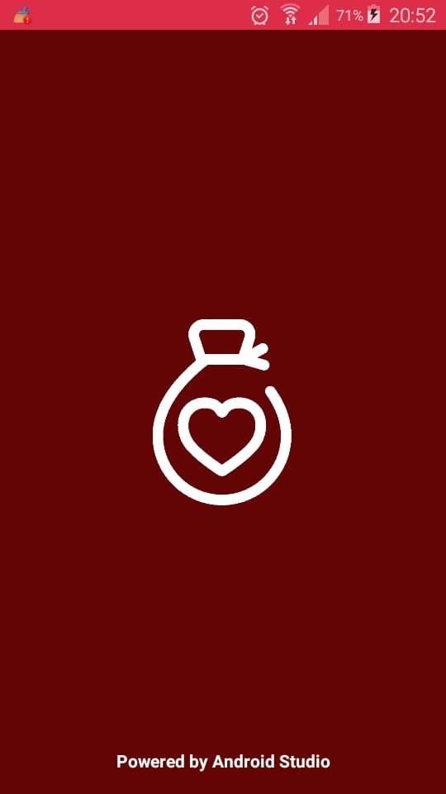
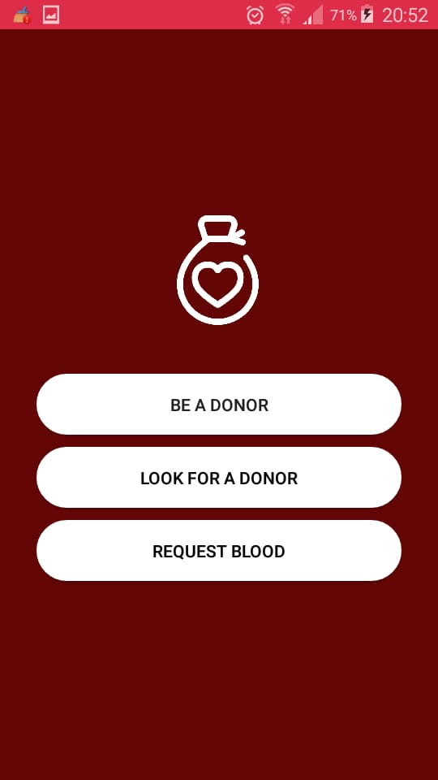
Android Application

Slide 11
CONCLUSION
Today the world is become a global village where every thing is online.
There are so many web based solutions provided in the market for the comfort of the people.
But without blood human being is non living, just by providing the web solution of blood bank management information system is just one more step in order to serve the mankind.

Slide 12
THANK YOU…

